Slide 1
Diffusion Journal Club 3: Motion-related Signal Behavior and Motion-Compensated Gradients
Ruiqi Geng
Jan 13, 2021

Slide 2
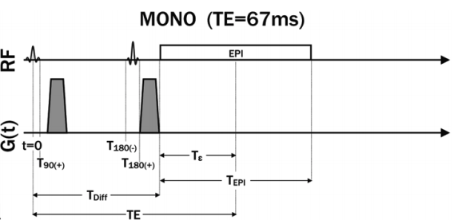
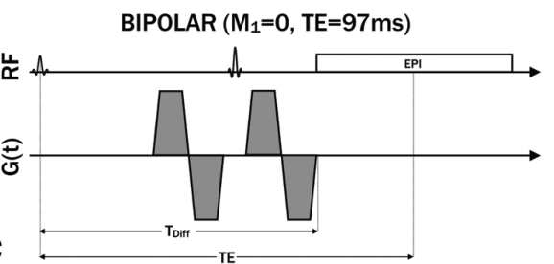
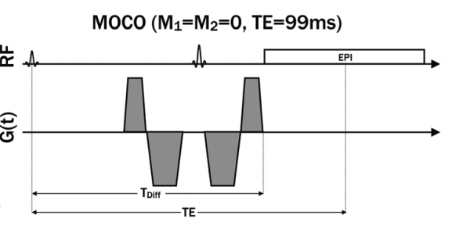
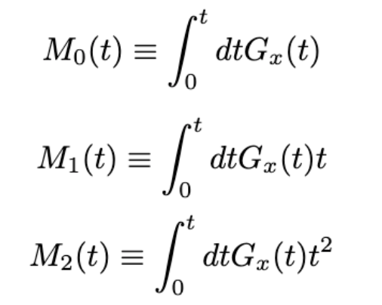
Diffusion encoding gradient
Monopolar:
Clinical convention
Sensitivity to cardiac & respiratory bulk motion --> signal loss
Cardiac & respiratory gating with limited success
Motion-compensated (MOCO):
Velocity and acceleration-compensated waveforms (M₁=M₂=0) → improve dramatically the bulk motion robustness of cardiac DWI
Long TE → more on optimization strategies later
Moments of the gradients:
→ more on signal modeling
Velocity compensated diffusion-encoding gradient waveforms (M₁=0) have been implemented in the liver and demonstrate improved ADC measurement reproducibility without respiratory or cardiac triggering
Notes:
My simulation is not perfect

Slide 3
Motion Simulation
Brownian motion
Brownian motion + Coherent, time-invariant motion
Brownian motion + Coherent, time-variant motion
Brownian motion + Incoherent (spread of velocities), time-invariant motion
Brownian motion + Incoherent, time-variant motion
Coherent, time-invariant motion
Coherent, time-variant motion
Incoherent, time-invariant motion
Incoherent, time-variant motion
Notes:
Vote: raise your hand if you think each kind of motion would cause problem in our traditional monopolar waveform

Slide 4
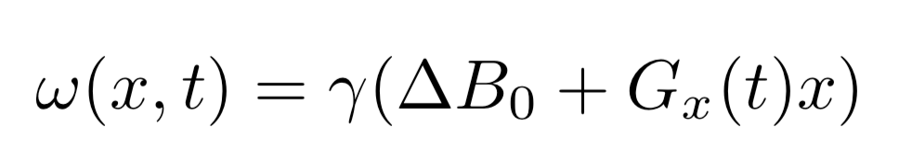
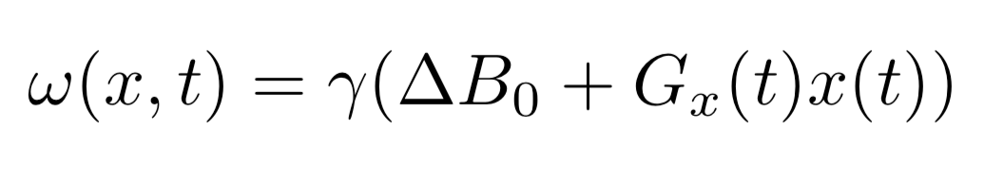
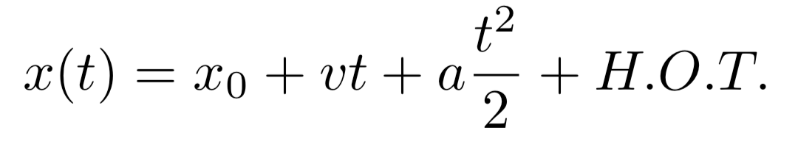
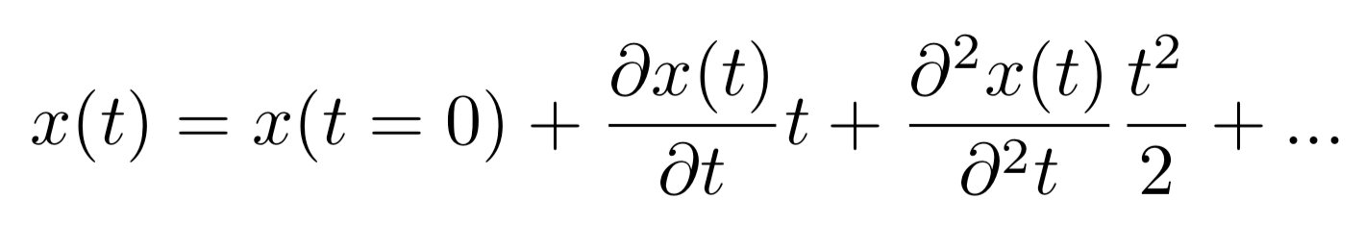
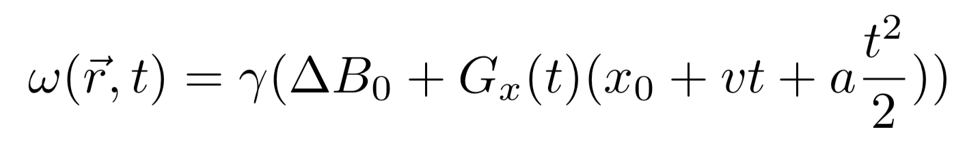
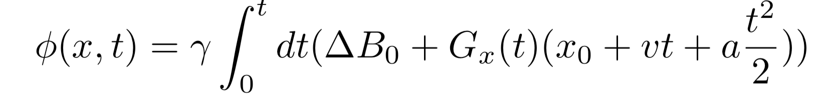
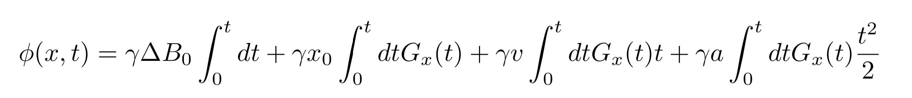
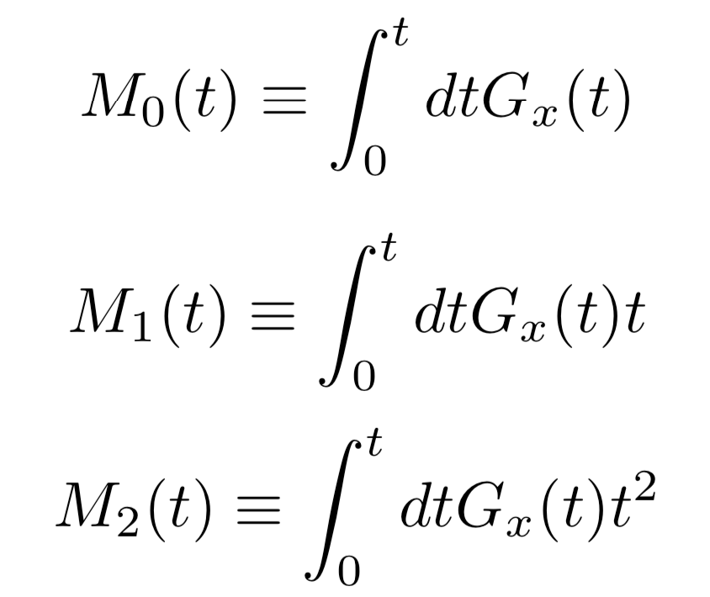
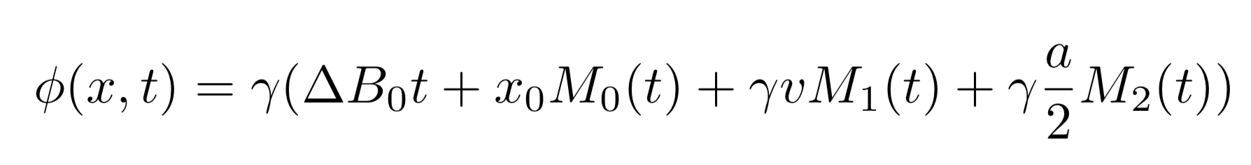
Signal Model from Moving Molecule
Single spin’s frequency proportional to longitudinal magnetic field strength:
For a moving molecule, position as a function of time:
Taylor expansion of a particle’s position:
Frequency written in terms of initial position, velocity, acceleration:
After tipping a spin at t=0, phase accrued over t is integral of frequency:
Separable integral:
Moments of gradients defined:
Simplified phase equation:

Slide 5
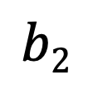
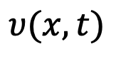
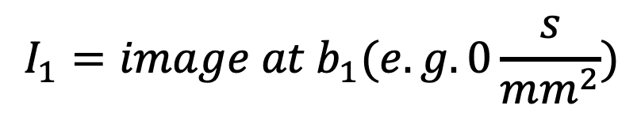

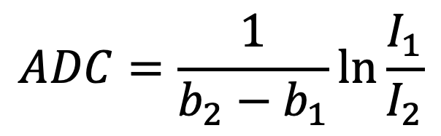
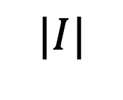
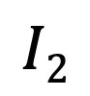
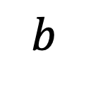
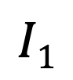
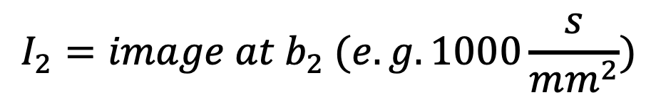
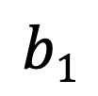
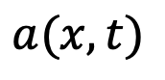
Motion-related Signal Loss
When and why is monopolar gradient waveforms insufficient?
Leads to bias in ADC calculation
$$a(x, t)$$
$$υ(x, t)$$
$$\left|I\right|=I_{0}e^{−b∙ADC}$$
$$|I|$$
ADC using two points on the curve:
$$I_{1}=image at b_{1}(e.g. 0\frac{s}{mm^{2}})$$
$$I1$$
$$I_{2}=image at b_{2} (e.g. 1000\frac{s}{mm^{2}})$$
$$I2$$
$$ADC=\frac{1}{b_{2}−b_{1}}\ln{\frac{I_{1}}{I_{2}}}$$
$$b1$$
$$b2$$
$$b$$

Slide 6
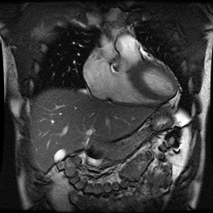
Signal Voids in DWI
DW images at different points in cardiac cycle
Notes:
Due to the heart pounding on the liver, absence of signal occurs at different locations in cardiac cycle, as indicated by arrows

Slide 7
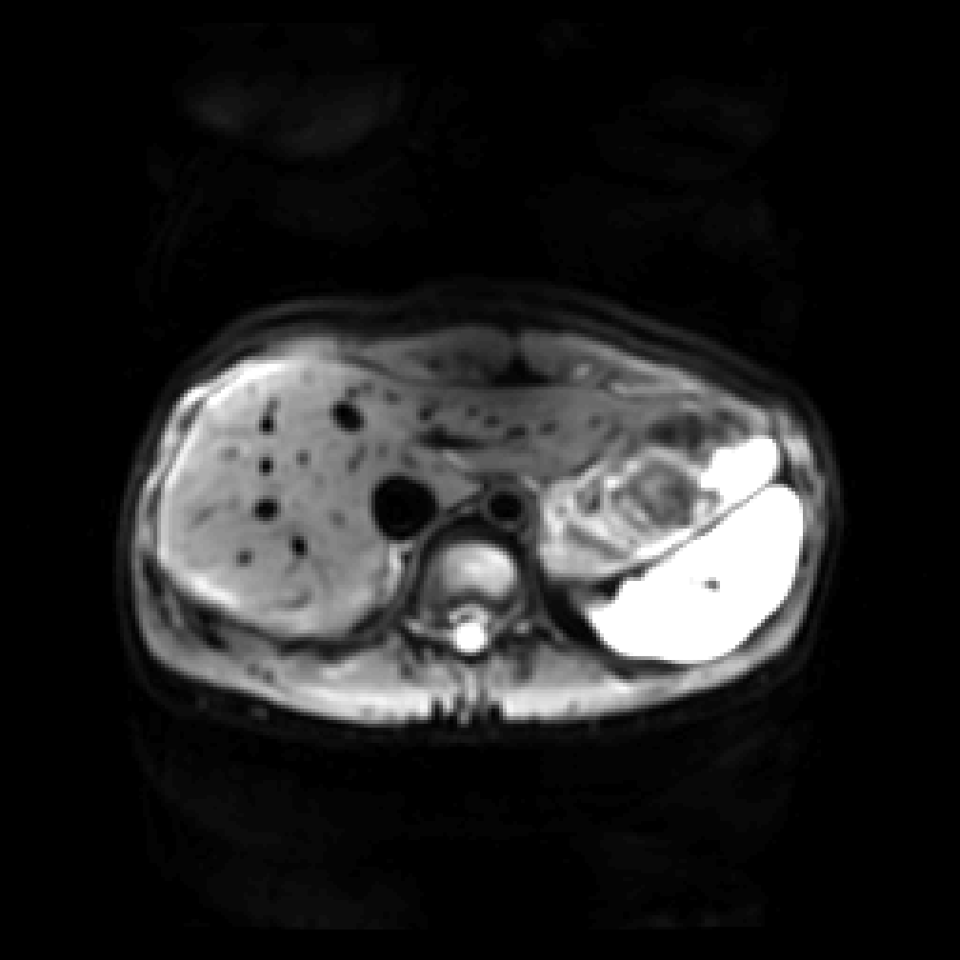
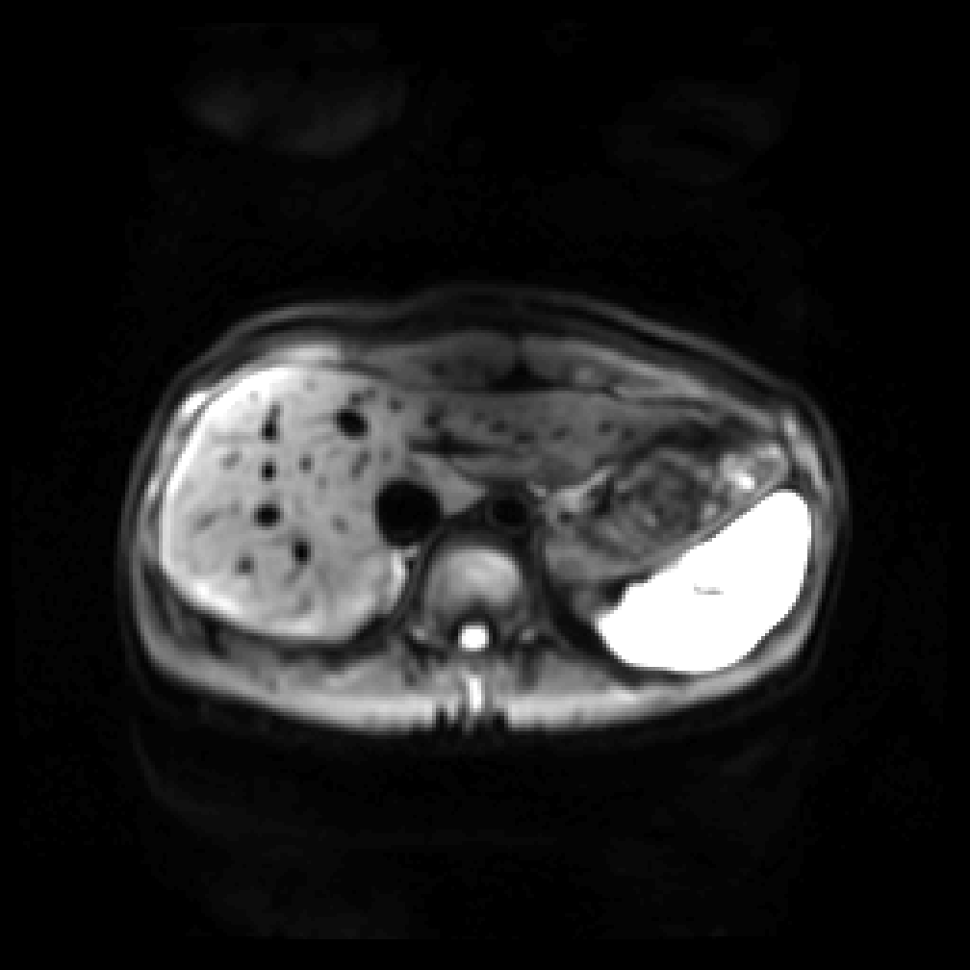
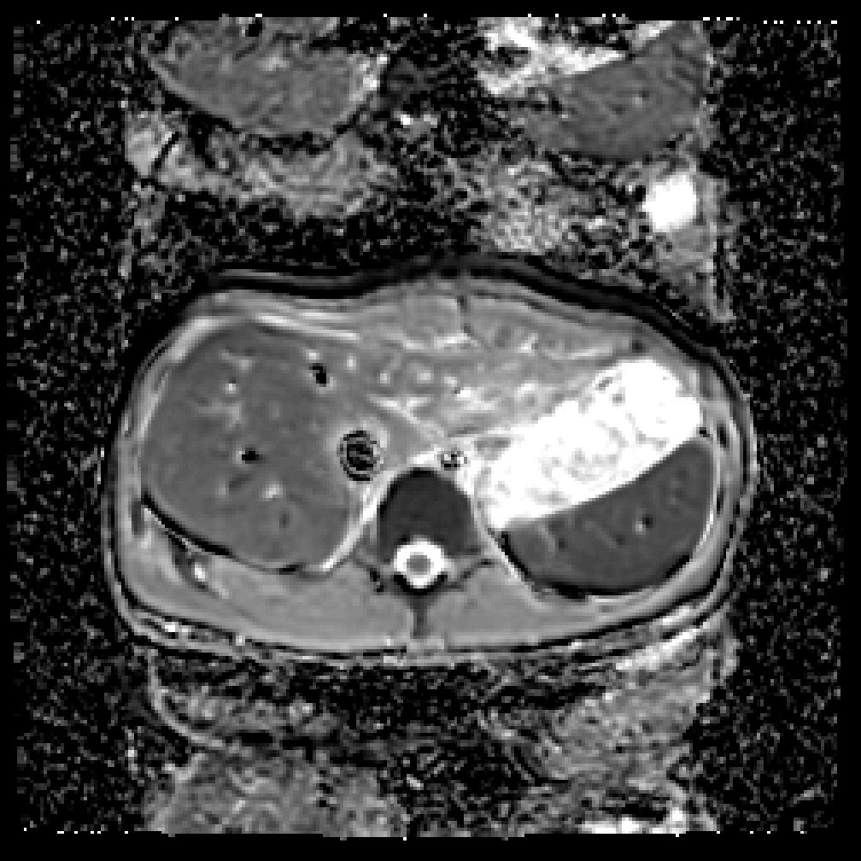
Clinical Liver DWI: Monopolar DW Waveform
b = 50 s/mm² b = 500 s/mm² ADC map ($×{10}^{−3}$ mm²/s)
Diffusion Directions | 3
b values (s/mm²) | 50 | 500
# of repetitions / direction | 4 | 8
Slice thickness | 6 mm
Fat Sat | SS excitation
Gating | RT
1.1
1.9
Bias in quantitative diffusion measurements
Kwee, TC., MAGMA, 2009.
Saito, K., World journal of radiology, 2016.
Notes:
That signal void manifests in the inaccurately high ADC values measured in left lobe of the liver in clinical scans using monopolar diffusion-weighted waveforms.

Slide 8
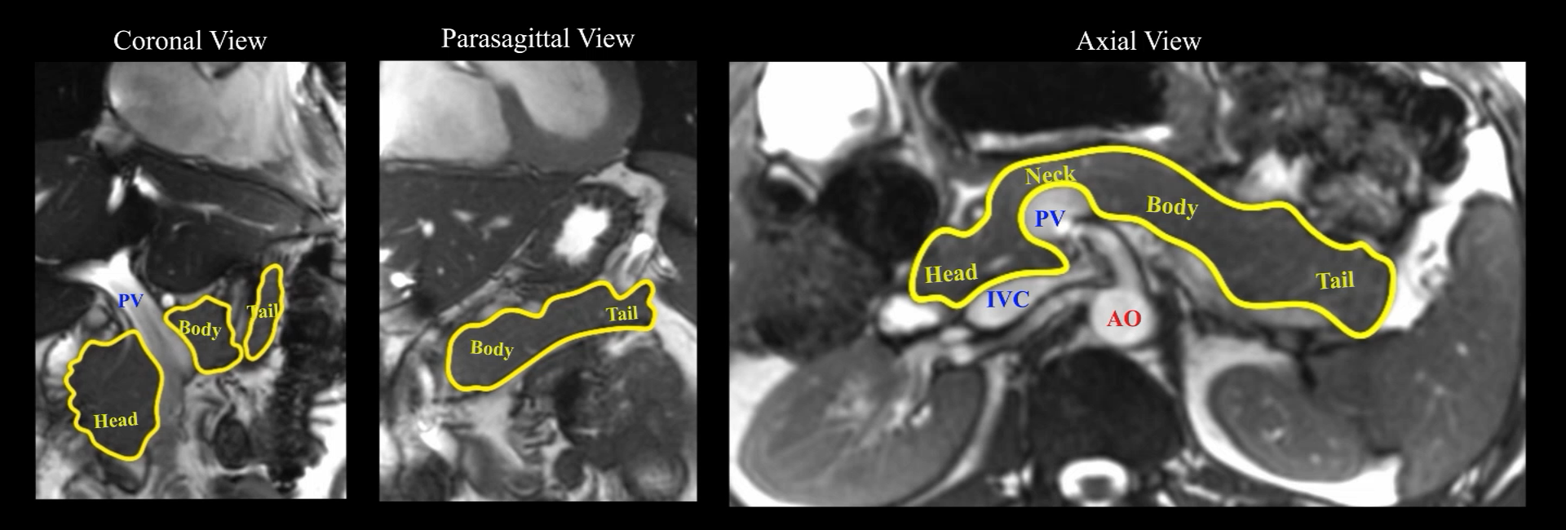
Notes:
Supporting Information Figure S2. Cardiac-gated dynamic SSFP images of the pancreas in coronal, parasagittal, and axial views. Pulsation of the aorta, as well as motion near the portal vein, inferior vena cava, and splenic vein caused substantial translational and compressive motion of the pancreas head and body. Bowel motion, or peristalsis, also appeared to cause slight motion in the pancreas (see Supporting Information Figure S4).

Slide 9
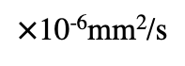
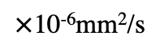
SI
SI
Standard Monopolar Gradient Waveform
Motion-Compensated Gradient Waveform
AP
AP
b=500 s/mm²
Head
RL
RL
ADC
3000
$×$10⁻⁶mm²/s
0
Body & Tail
b=500 s/mm²
ADC
3000
$×$10⁻⁶mm²/s
0
Notes:
Figure 3. Single-slice breath-hold diffusion-weighted images with b = 500 s/mm² and ADC maps in three diffusion directions, at cardiac (peripheral-gating) trigger delay = 20 ms. The orange contours were drawn from DWI b = 50 s/mm² and overlaid on DWI b = 500 s/mm² to indicate pancreas location. Using a standard monopolar DW waveform, heterogeneous DW signals and ADC values were observed across the pancreas in all diffusion directions. Using a motion-compensated DW waveform, DW signals and ADC values appeared relatively uniform across the pancreas.

Slide 10
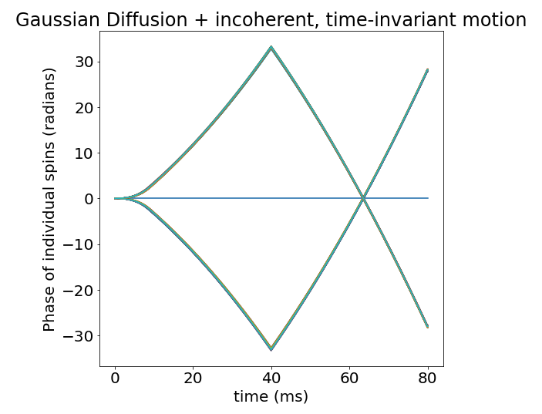
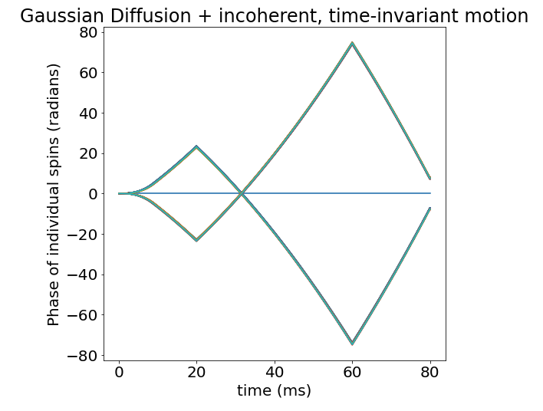
Discussions from simulations
When and how is a monopolar gradient waveform insufficient?
What issues can M1/M2-nulled gradients address?
– time-invariant velocities (2), no acceleration
Monopolar
M1-nulled

Slide 11
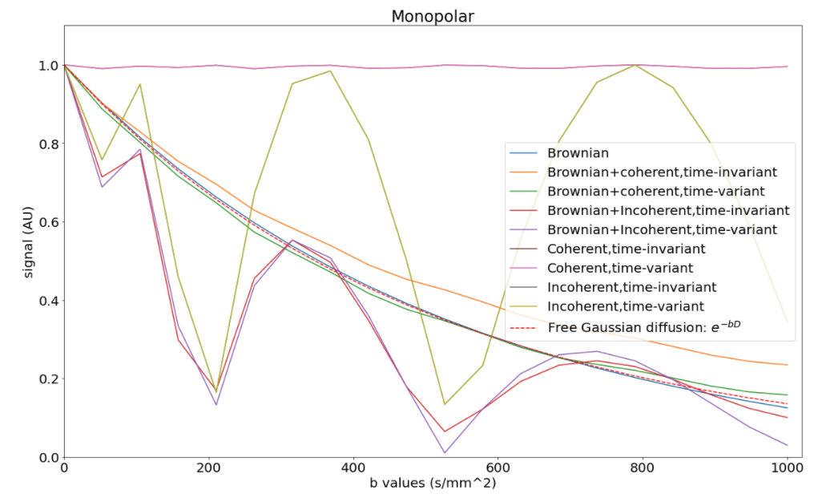
Discussions from simulations – time-invariant velocities, no acceleration
When and why is a monopolar gradient waveform insufficient?
When does a monopolar still do well?
M1-nulled

Slide 12
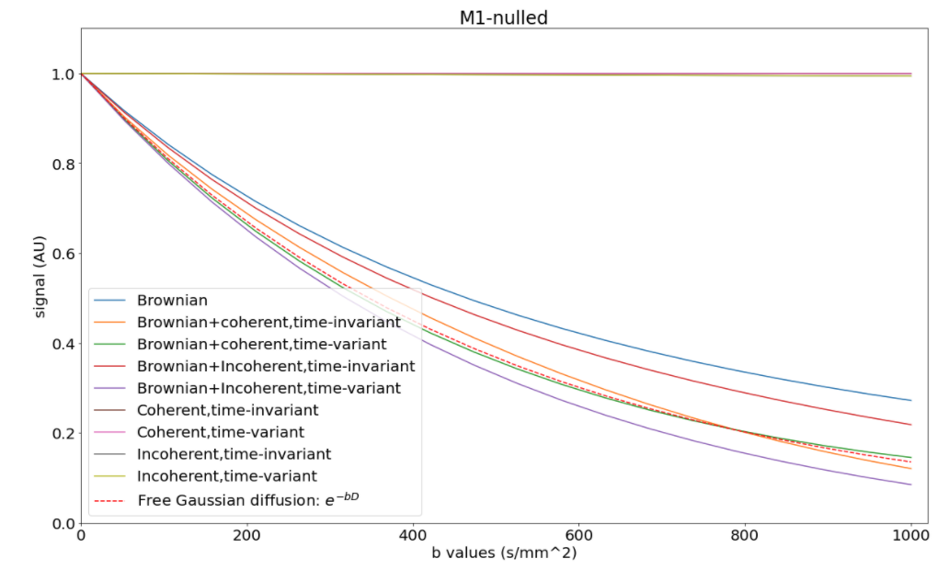
Discussions from simulations – time-invariant velocities, no acceleration
What issues can M1-nulled gradients address?

Slide 13
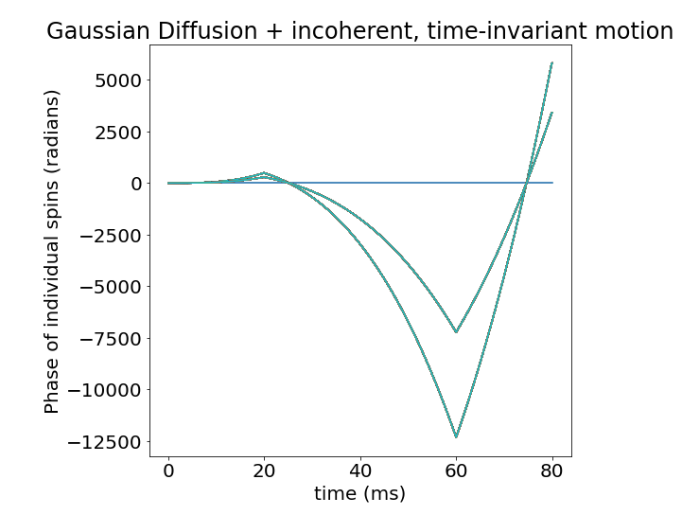
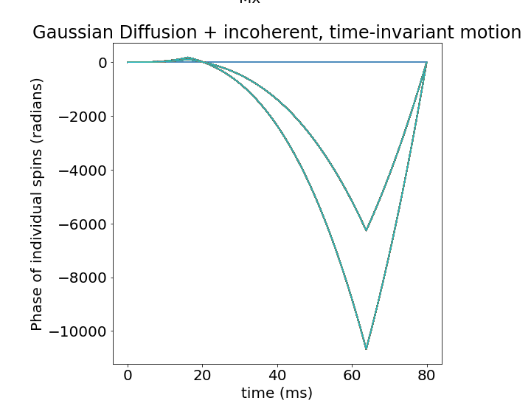
Discussions from simulations
When and how is a monopolar gradient waveform insufficient?
What issues can M1/M2-nulled gradients address?
– time-invariant accelerations (2), no initial velocity
M1-nulled
M2-nulled

Slide 14
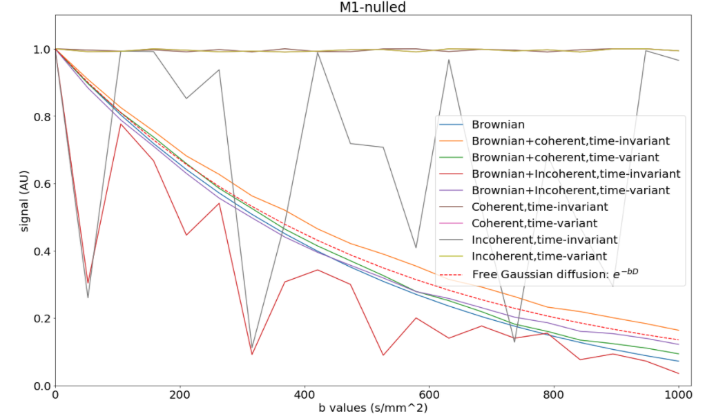
Discussions from simulations – time-invariant accelerations, no initial velocity
What are the limitations of M1-nulled gradients address?

Slide 15
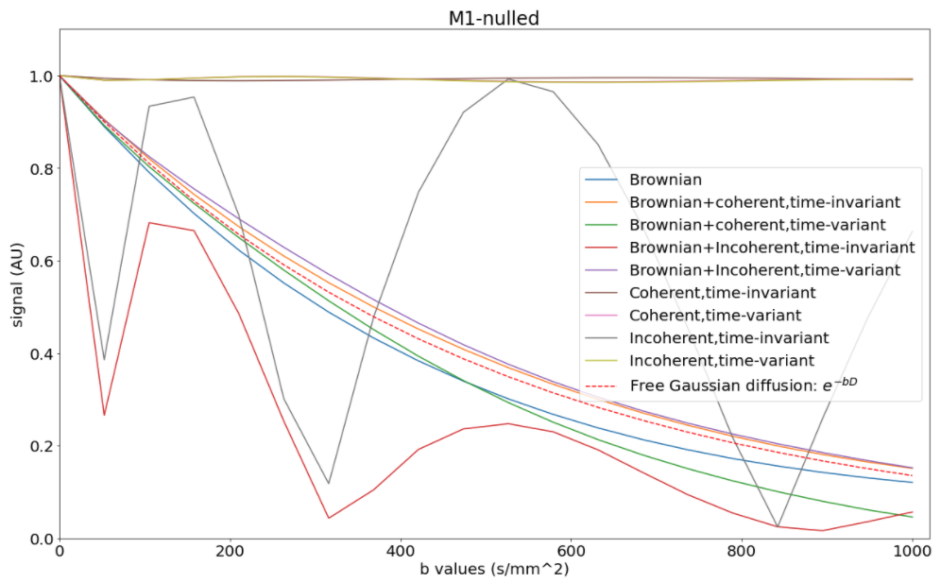
Discussions from simulations – time-invariant accelerations, no initial velocity
What are the advantages of M2-nulled gradients over M1-nulled gradients?
What issues can’t M2-nulled gradients address?

Slide 16
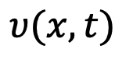
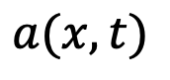
Discussions from simulations
When and how is a monopolar gradient waveform insufficient?
What issues can M1/M2-nulled gradients address?
What issues can’t M1/M2-nulled gradients address? (time-variance)
Why M1/M2-nulled gradients can’t refocus spins with time-variant motion?
Isolating the effects of Brownian motion?
$$a(x, t)$$
$$υ(x, t)$$

Slide 17
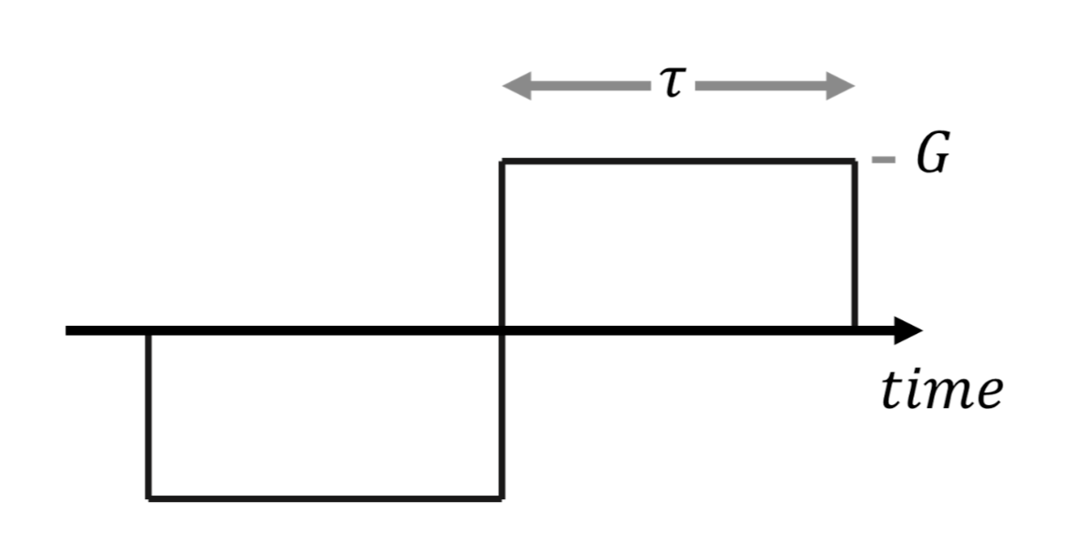
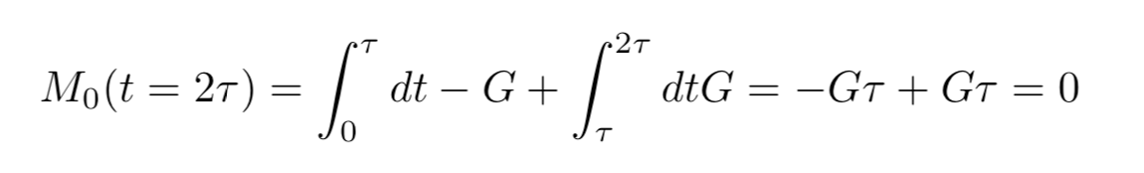
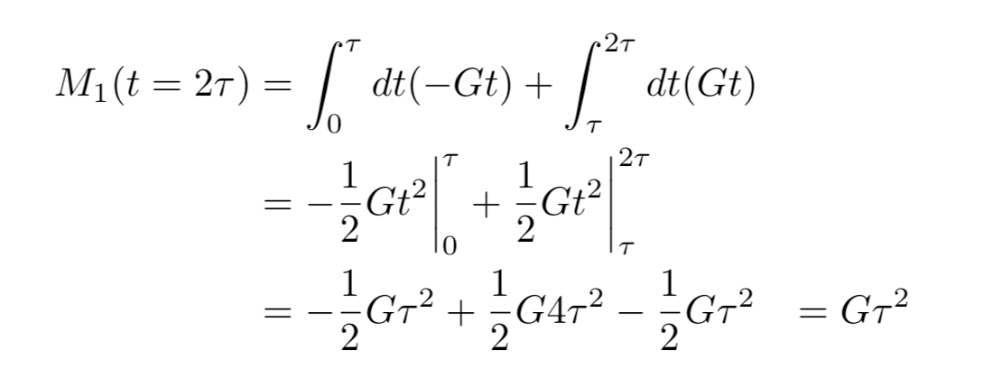
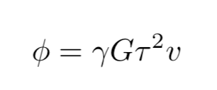
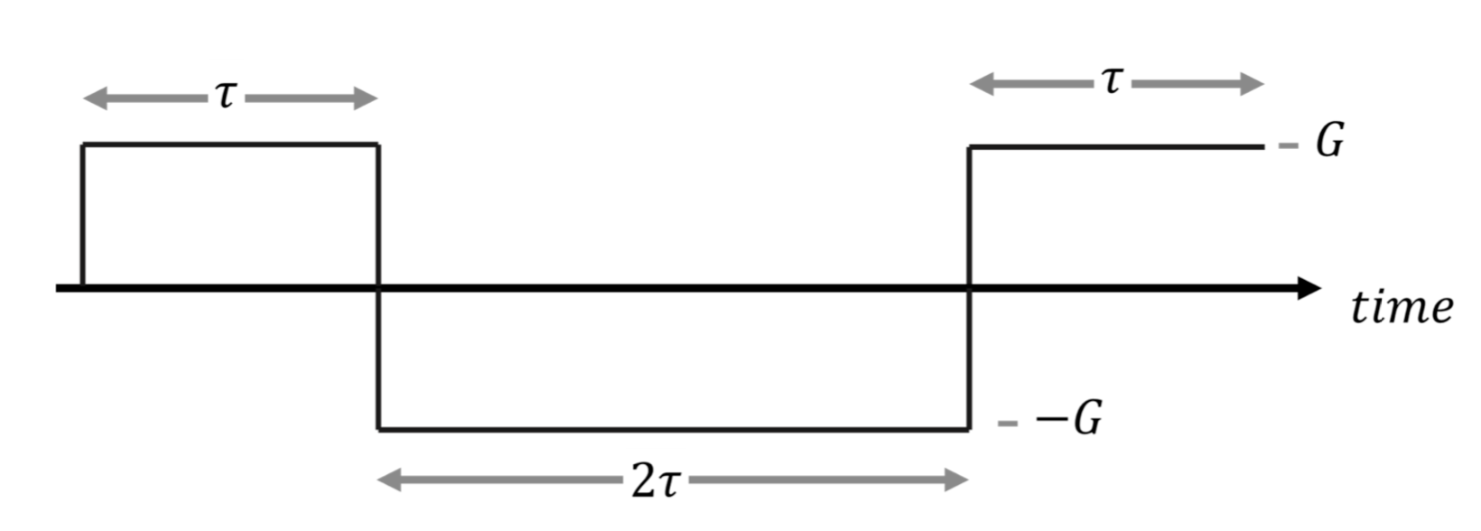
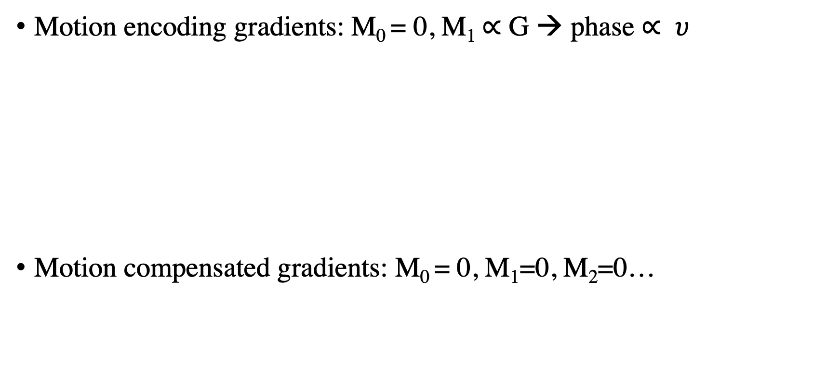
Motion encoding vs. Motion compensation
Motion encoding gradients: M₀ = 0, M₁$∝$ G → phase $∝ υ$
Motion compensated gradients: M₀ = 0, M₁=0, M₂=0…

